Slide 2
Notes:
Fake news – a hotly-debated topic in recent years. A primary reason for that is more and more people are starting to rely on online news sources

Slide 3
The
Americans using online news sources
67,446,100 (2018)
Guardian
Notes:
In 2018, more than 67million used internet to read news. 80% of them believe fake news is a bigger threat than terrorism
74% also believe they should know if it real or fake
Being one amongst them and a Data scientist, I want to address this
major problem but do not know how to identify it
remove 2017. hide and grey

Slide 4
The
Americans using online news sources
67,446,100 (2018)
Guardian
80% fake news is a bigger threat than terrorism
Notes:
In 2018, more than 67million used internet to read news. 80% of them believe fake news is a bigger threat than terrorism
74% also believe they should know if it real or fake
Being one amongst them and a Data scientist, I want to address this
major problem but do not know how to identify it
remove 2017. hide and grey

Slide 5
The
Americans using online news sources
67,446,100 (2018)
Guardian
80% fake news is a bigger threat than terrorism
74% want to know fake or real
Notes:
In 2018, more than 67million used internet to read news. 80% of them believe fake news is a bigger threat than terrorism
74% also believe they should know if it real or fake
Being one amongst them and a Data scientist, I want to address this
major problem but do not know how to identify it
remove 2017. hide and grey

Slide 6

Americans using online news sources
67,446,100 (2018)
80% fake news is a bigger threat than terrorism
74% inclined to know fake or real
Provoke violence and hate crime!!!
Notes:
In 2018, more than 67million used internet to read news. 80% of them believe fake news is a bigger threat than terrorism
74% also believe they should know if it real or fake
Being one amongst them and a Data scientist, I want to address this
major problem but do not know how to identify it
remove 2017. hide and grey

Slide 7
Fact or Fake Fake News Detector
By
Uma Krithika

Slide 8

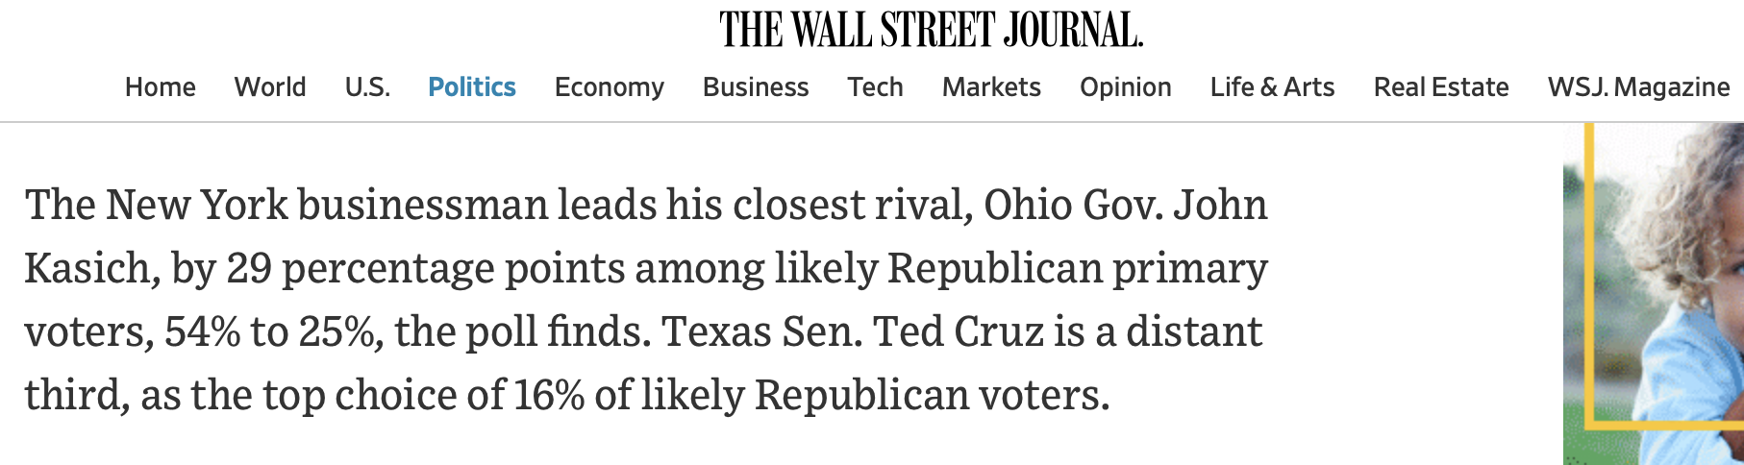
Building the detector…
6K+ articles
(50-50 fake-real)
Notes:
paragraph
working with text data is challenging as it is complex, mysterious, does not follow logic yet very intriguing
‘It's primary day in New York and front-runners Hillary Clinton and Donald Trump are leading in the polls. ’
data - pic of a news paper with 2016 - 6300(50 -50)

Slide 9
Building the detector…
6K+ articles
(50-50 fake-real)
Tokenize
[‘new’, ‘york’, ‘businessman’, ‘lead’, ‘close’, ‘rival’, ‘ohio’, ‘john’, ‘kasich’, ‘percentage’, ‘point’, ‘republican’…]
Notes:
paragraph
working with text data is challenging as it is complex, mysterious, does not follow logic yet very intriguing
‘It's primary day in New York and front-runners Hillary Clinton and Donald Trump are leading in the polls. ’
data - pic of a news paper with 2016 - 6300(50 -50)

Slide 10
Building the detector…
6K+ articles
(50-50 fake-real)
Tokenize
Binary word count
[‘new’, ‘york’, ‘businessman’, ‘lead’, ‘close’, ‘rival’, ‘ohio’, ‘john’, ‘kasich’, ‘percentage’, ‘point’, ‘republican’…]
[ 0, 1, 1, 0, 1, 0, 0, 0, 1 … ]
Notes:
paragraph
working with text data is challenging as it is complex, mysterious, does not follow logic yet very intriguing
‘It's primary day in New York and front-runners Hillary Clinton and Donald Trump are leading in the polls. ’
data - pic of a news paper with 2016 - 6300(50 -50)

Slide 11

Building the detector
6K+ articles
(50-50 fake-real)
Tokenize
Binary word count
Model
88.53% Accuracy
0 10 20 30 40 50 60 70 80 90
Notes:
working with text data is challenging as it is complex, mysterious, does not follow logic yet very intriguing
‘It's primary day in New York and front-runners Hillary Clinton and Donald Trump are leading in the polls. ’
data - pic of a news paper with 2016 - 6300(50 -50)
workflow - fake elimination process
log reg full name
why is it imp- fake news has been causing riots around the world. now let me tell how i did it

Slide 12
It’s not enough to know if a model works, we need to know how it works
Sundar Pichai, CEO, Google

Slide 13
What did they talk about?
Real news
Frontrunners
Democrats
Republicans
Notes:
Bernie Sanders
Hillary Clinton
Carly Fiorina,
Marco Rubio,
John Boehner,
Donald Trump

Slide 14
What did they talk about?
Real news
Frontrunners
Democrats
Republicans
Fake news
Email
John Podesta
Infowars
Notes:
a far-right American conspiracy and fake news website
use actual bullet instead of arrow

Slide 15
Distinction in name choice
Real news
Fake news
12
667
Hillary
742
77
Clinton

Slide 16
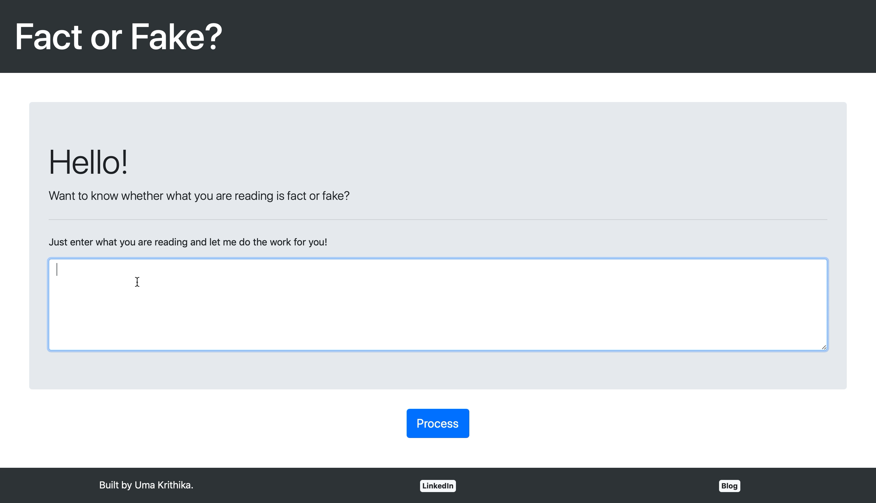
Demo
Hurray, I’m 78.48% confident that this is real news!

Slide 17
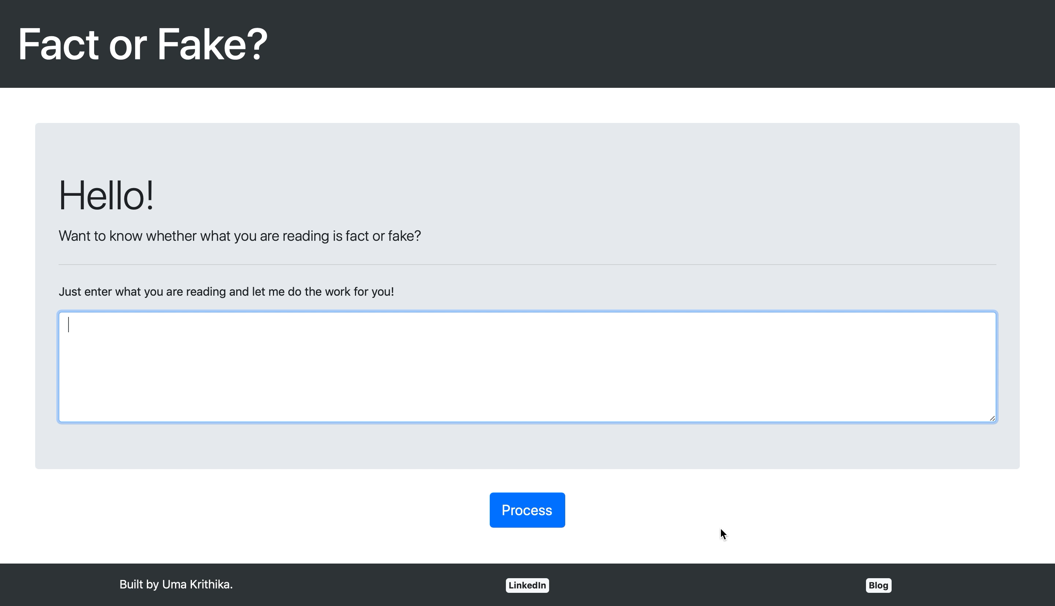
Demo
Hmmm… I’m 97.49% confident that this is fake news!
Notes:
Well this was looking backwards. to look forward
Updating dataset to keep up with the growing number of articles is a way. followed by retraining and re evaluating every single time.
While doing that, a pressing question that needs to be kept in mind is that who decides whether an article is credible or not? Currently It is on the audience. But can you rely entirely on audience to generate that insight?
With that question to ponder, I sign off!
, probs faced
data u wish u had
relavent issues for next yr, how would u prep for fdake news filter
see if sentence length
pop one by one

Slide 18
Next steps…
Notes:
Well this was looking backwards. to look forward
Updating dataset to keep up with the growing number of articles is a way. followed by retraining and re evaluating every single time.
While doing that, a pressing question that needs to be kept in mind is that who decides whether an article is credible or not? Currently It is on the audience. But can you rely entirely on audience to generate that insight?
With that question to ponder, I sign off!
, probs faced
data u wish u had
relavent issues for next yr, how would u prep for fdake news filter
see if sentence length
pop one by one

Slide 19
Next steps…
Additional parameters
Notes:
align to borders
Well this was looking backwards. to look forward
Fb pages, twitter accounts, websites
Updating dataset to keep up with the growing number of articles is a way. followed by retraining and re evaluating every single time.
While doing that, a pressing question that needs to be kept in mind is that who decides whether an article is credible or not? Currently It is on the audience. But can you rely entirely on audience to generate that insight?
With that question to ponder, I sign off!
implement thins model we change the way people understand fake and reak news
make 2020 ur last point and ask ppl to come
, probs faced
data u wish u had
relavent issues for next yr, how would u prep for fdake news filter
see if sentence length
pop one by one

Slide 20
Next steps…
Additional parameters
Browser add-on
Notes:
align to borders
Well this was looking backwards. to look forward
Fb pages, twitter accounts, websites
Updating dataset to keep up with the growing number of articles is a way. followed by retraining and re evaluating every single time.
While doing that, a pressing question that needs to be kept in mind is that who decides whether an article is credible or not? Currently It is on the audience. But can you rely entirely on audience to generate that insight?
With that question to ponder, I sign off!
implement thins model we change the way people understand fake and reak news
make 2020 ur last point and ask ppl to come
, probs faced
data u wish u had
relavent issues for next yr, how would u prep for fdake news filter
see if sentence length
pop one by one

Slide 21
Next steps…
Additional parameters
Browser add-on
Upgrade for 2020 elections
Notes:
Well this was looking backwards. to look forward
Fb pages, twitter accounts, websites
Updating dataset to keep up with the growing number of articles is a way. followed by retraining and re evaluating every single time.
While doing that, a pressing question that needs to be kept in mind is that who decides whether an article is credible or not? Currently It is on the audience. But can you rely entirely on audience to generate that insight?
With that question to ponder, I sign off!
implement thins model we change the way people understand fake and reak news
make 2020 ur last point and ask ppl to come
, probs faced
data u wish u had
relavent issues for next yr, how would u prep for fdake news filter
see if sentence length
pop one by one

Slide 22

THANKS!
umakrithika.n@outlook.com
datatoinsights.blog
uma-krithika
Let’s talk data science!
Notes:
GITHUB!!!

